Slide 1
Cyber Security
BY- RISHAB VERMA (2021UCA1946)
YASH DABAS (2021UCA1912)
JATIN (2021UCA1914)
UPANSHU DHANKHER (2021UCA1901)

Slide 2
Cyber Attacks
A cyberattack is a malicious and deliberate attempt by an individual or organization to breach the information system of another individual or organization. People and Organizations are targeted daily by cyber attackers.

Slide 3
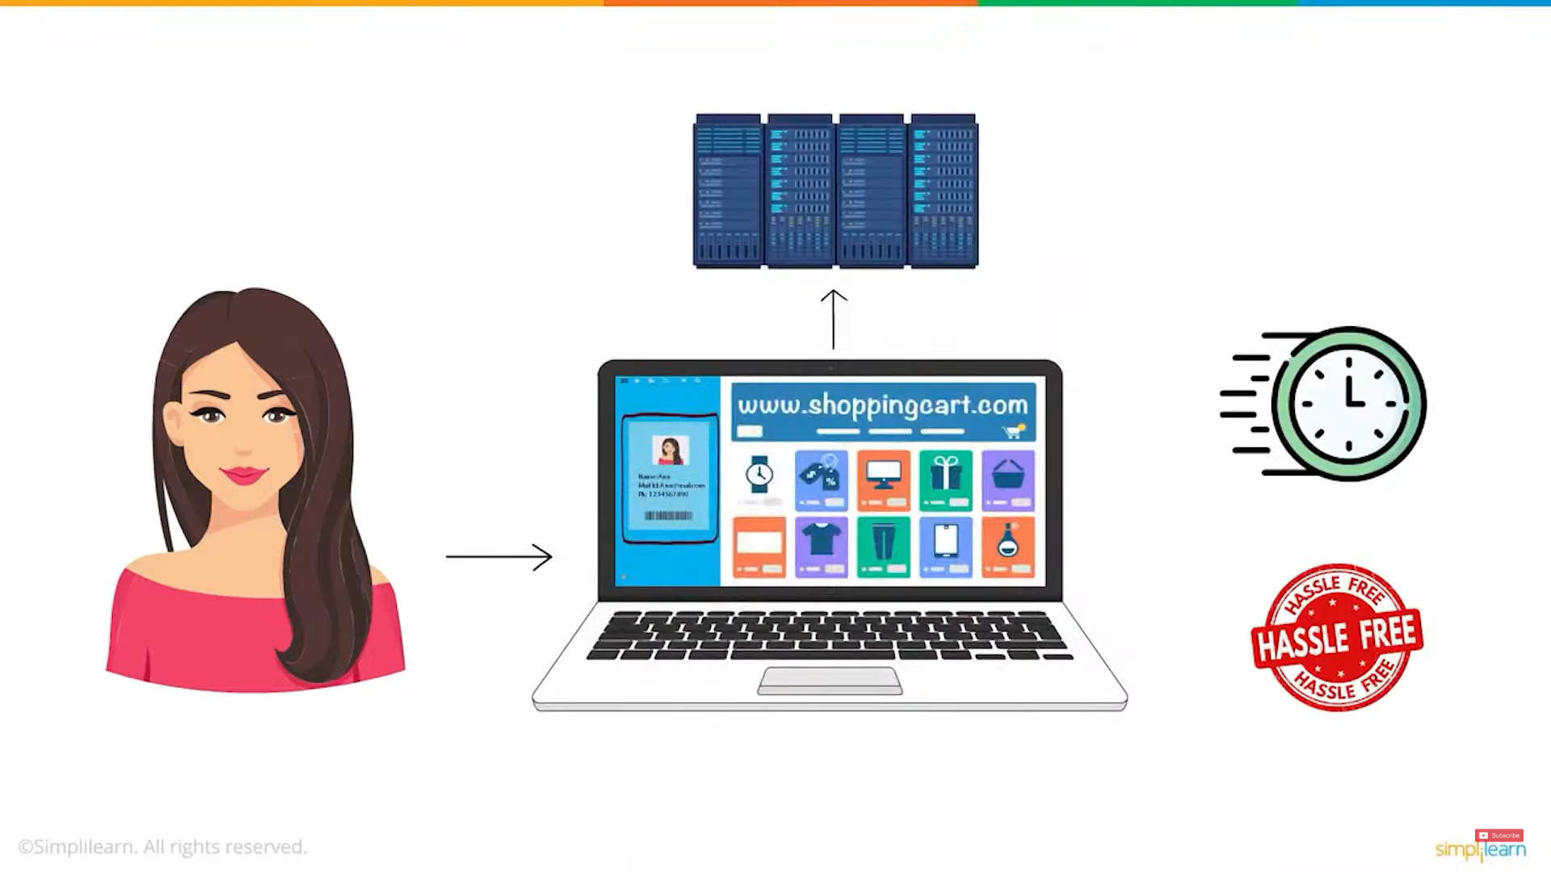
Here is one such example -
Kaylee often shops form www.shopingkart.com and has her information like email id and credit card details saved on the website to enable a fast and hassle-free shopping experience.

Slide 4
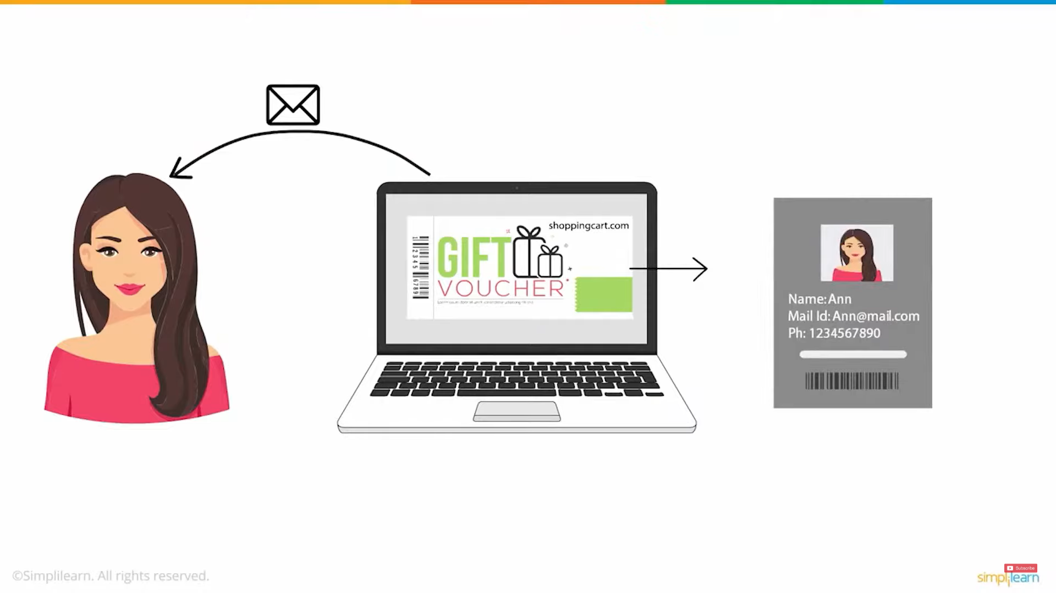
One day Kaylee received an email that stated her eligibility for a special discount voucher from shoppingkart.com
In order to receive the coupon code, she was asked to fill in her shopping kart.com account credentials.
It did not seem fishy to her at that time as she thought it was just an account verification step.

Slide 5
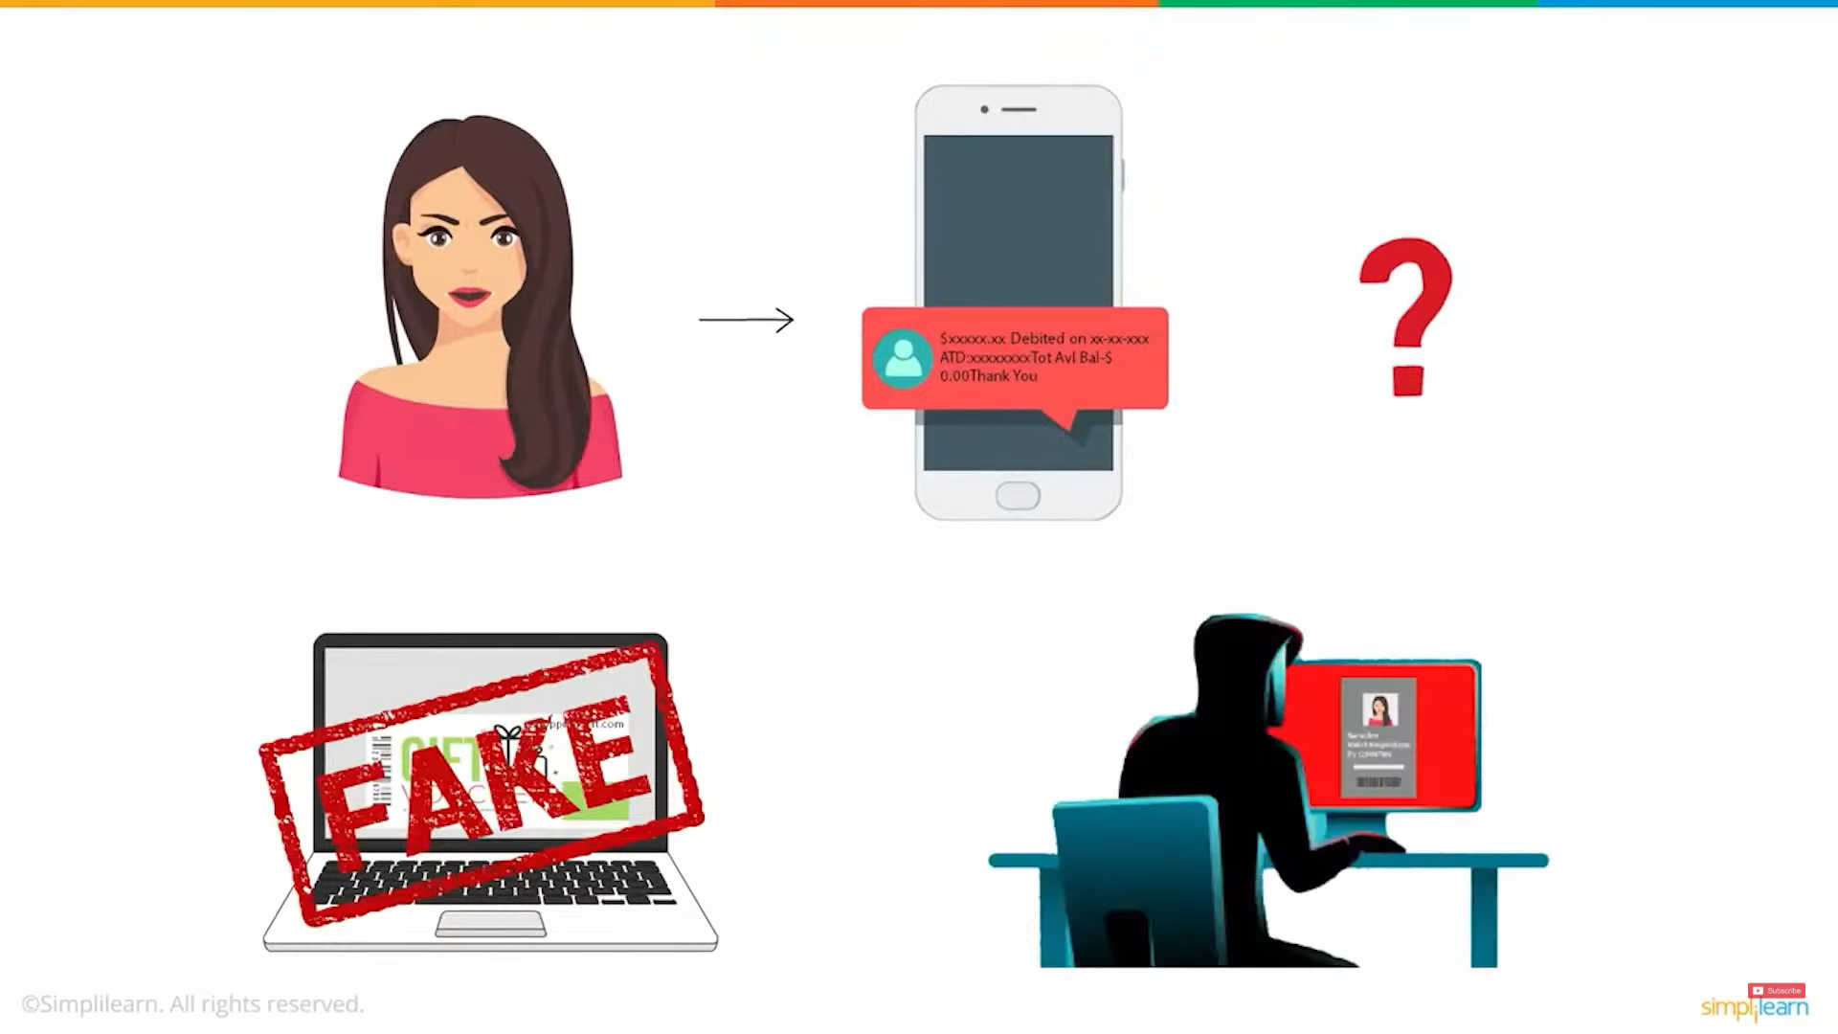
Little did she realize the danger she would be facing.
She was knocked off her feet when a substantial amount of money was wiped off her account.
This happened because the email she received was fake and her shoppingkart.com account witnessed unauthorized access from a third party.
This type of attack is known as a Cyber Attack and the person who carries it out is known as a Hacker.

Slide 6
Types of Cyber Attacks
A cyber attack happens when cybercriminals try to gain illegal access to electronic data stored on a computer or a network. The intent might be to inflict reputational damage or harm to a business or person, or theft of valuable data.
The five main different types of Cyber Attacks are the following-
1) Malware Attack
2) Social Engineering Attack
3) Man in the Middle
4) Denial of the Service Attack
5) SQL Injection Attack
These are explained in the following slides.

Slide 7

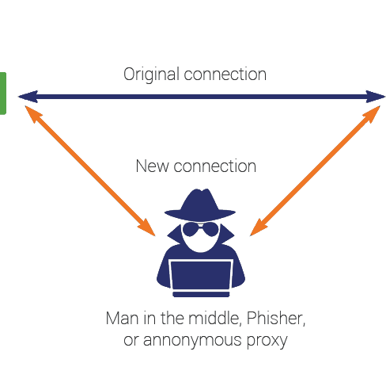
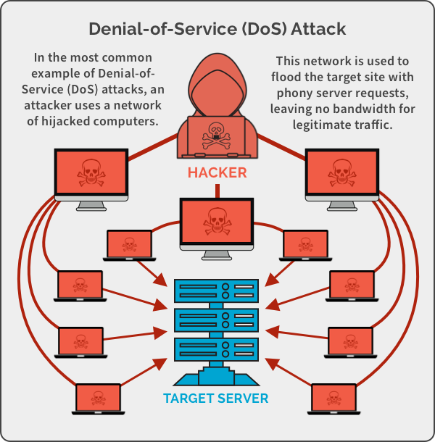
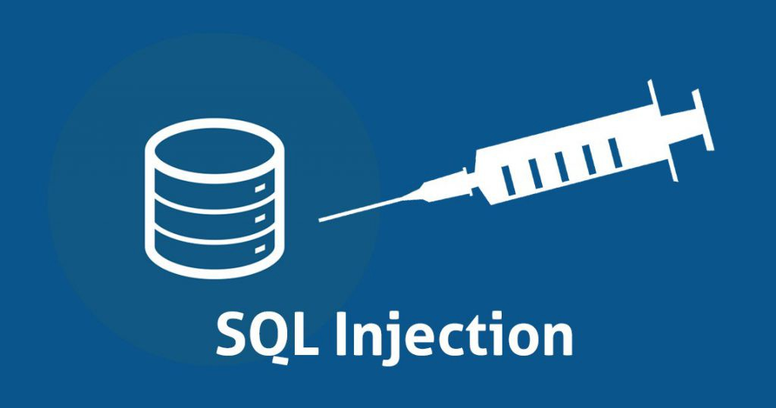
Five Types of Cyber Attacks
Malware Attack
Social Engineering Attack
Man in the Middle
Denial of the Service Attack
SQL Injection Attack

Slide 8
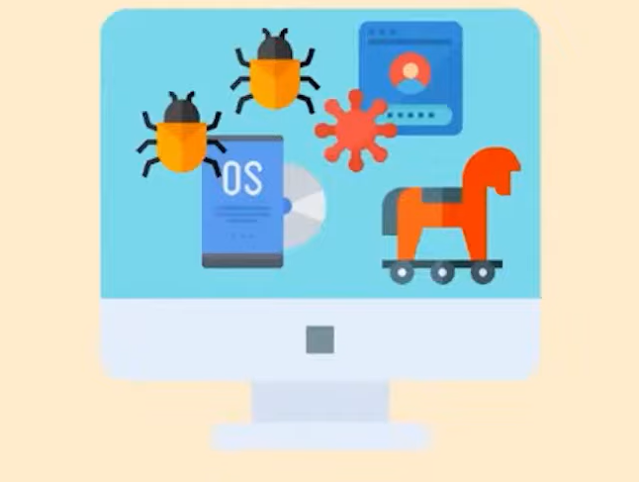
1. Malware Attack
Malware refers to malicious software, viruses, ransomware, and worms. Trojan virus is also a form of malware that disguises itself as a legitimate software.

Slide 9
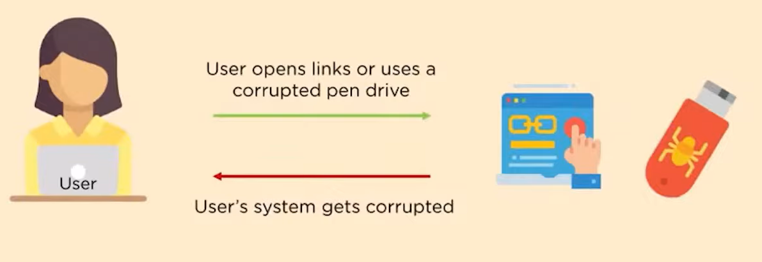
It gets into a system when the user clicks on suspicious links or downloads attachments or uses an infected pen drive. It then obtains all the information from the clients’s system.
Famous types of malware are keylogger, virus, trojan horse and worms.

Slide 10
2. Social Engineering Attack
It is the art of manipulating people so that they end up giving their confidential information. It is broken down into 3 categories: 1) Phishing Attack
2) Spear Phishing Attack
3) Whaling Phishing Attack
Phishing attack is a practice wherein the hacker usually sends fraudulent emails, which appear to be coming from a trusted source. It is done to install malware or to steal sensitive data like credit card information, and login credentials.
Spear Phishing is a variation of Phishing. Here, the attacker targets a specific individual or a group of people.

Slide 11
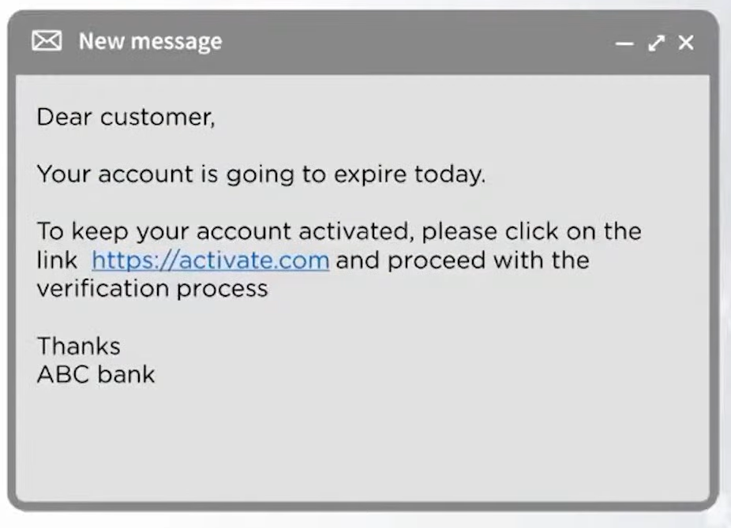
Whaling Phishing attack is a type of attack that specifically targets wealthy, powerful and prominent individuals.
For example: You get a mail like this

Slide 12
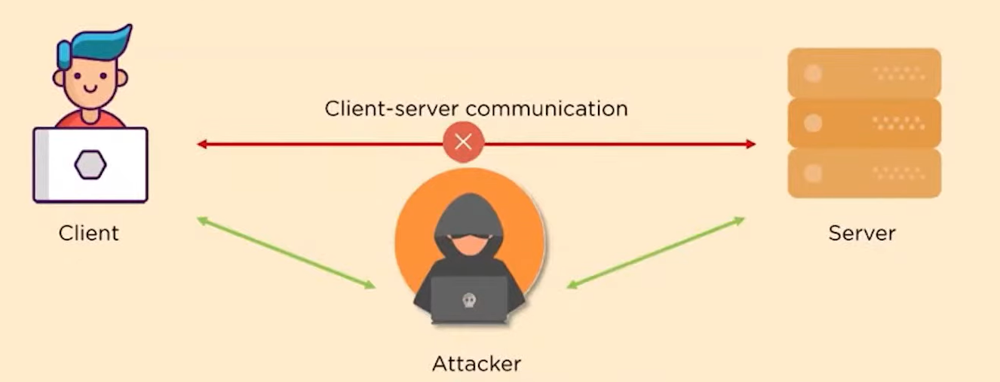
3. Man in the Middle Attack
The attacking computer takes the IP address of the client. Unaware of this, the server continues to communicate with the attacker. This happens in an unsecured Wi-Fi network and through malware.

Slide 13
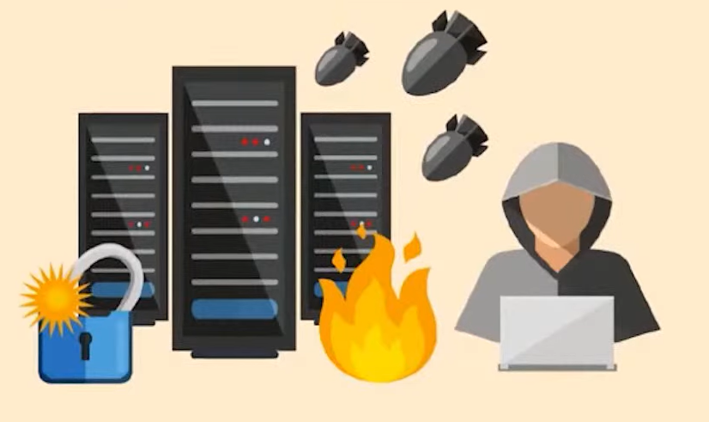
4. Denial of Service Attack
A Denial of Service attacks motive is to flood system and networks with traffic to exhaust its resources and bandwidth. By doing so, it is unable to cater to legitimate service requests.
When attackers use multiple systems to launch this attack, it is known as Distributed Denial of Service (DDOS) attack.

Slide 14
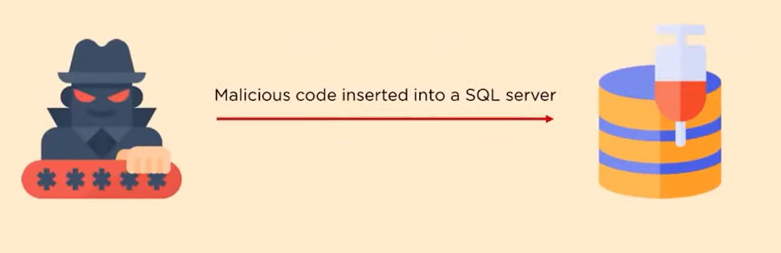
5. SQL Injection Attack
In a database-driven website, the hacker manipulates a standard SQL query. Malicious code is inserted into a SQL server to obtain information.
This attack allows hackers to view, edit, and delete tables in databases. In addition to this, the attackers can also obtain administrative rights.

